Slide 1
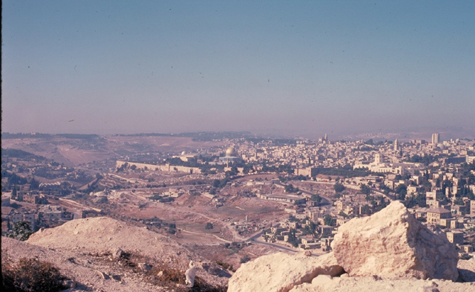
Life of Christ
By
Dr. Stephen C. Meyers

Slide 2
Life of Christ
Birth
Early Years
Ministry
Passion week

Slide 3
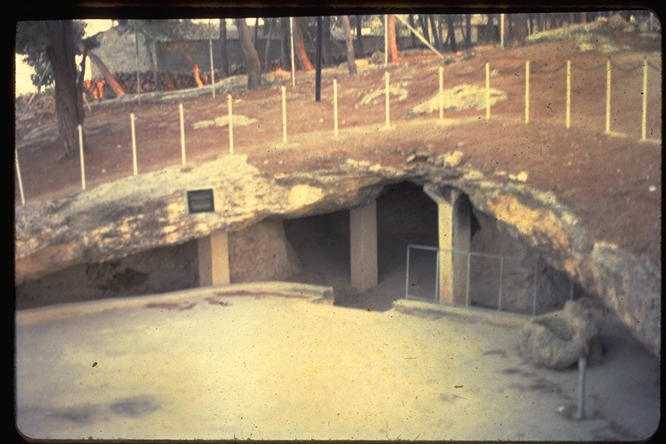
Bethlehem: Cave
Jesus is born in Bethlehem. Here is a typical cave in Bethlehem where animals where kept with a stone manger to feed the animals.
MANGER

Slide 4
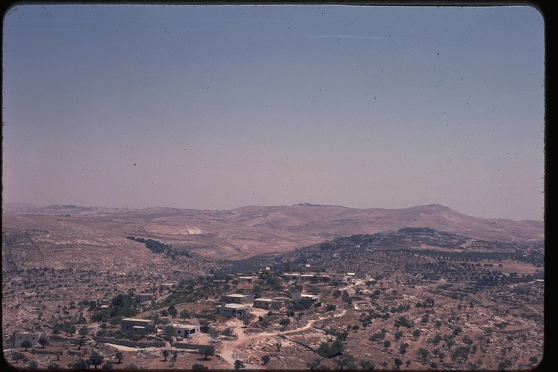
Hills of Judea
An Angel appeared to shepherds watching their flocks, and announces the birth of a savior.
Shepherds watched their flocks

Slide 5
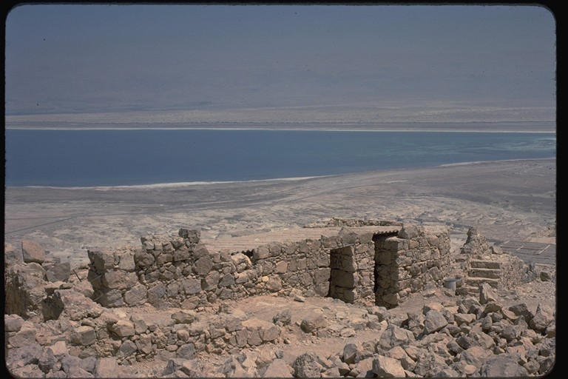
Masada
Wise men ( Magi) came seeking the new born baby who would be king of the Jews. Herod was upset and ordered all the babies killed in Bethlehem.
Herod’s Summer Palace

Slide 6
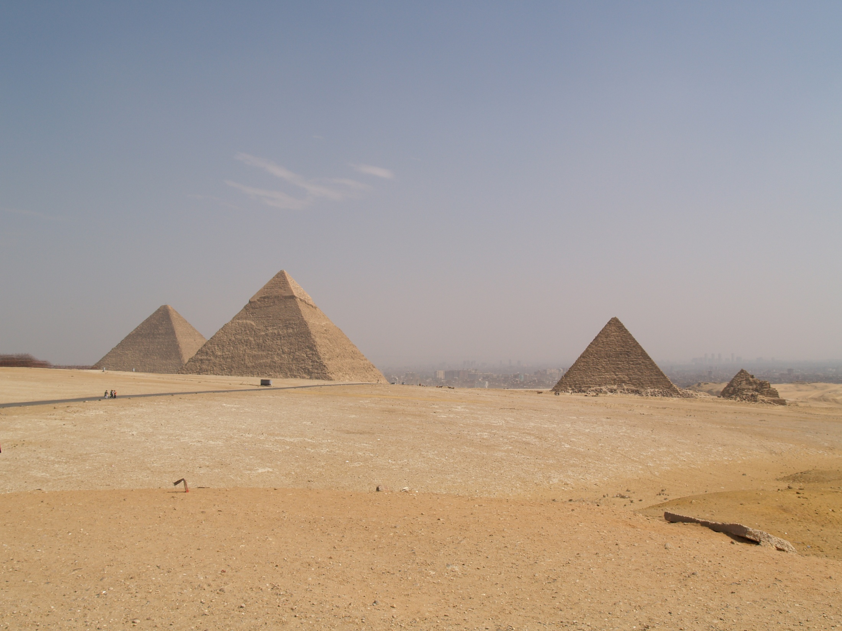
Jesus taken to Egypt
Being warned in a dream Joseph and Mary take Jesus to Egypt to escape Herod’s wrath.

Slide 7
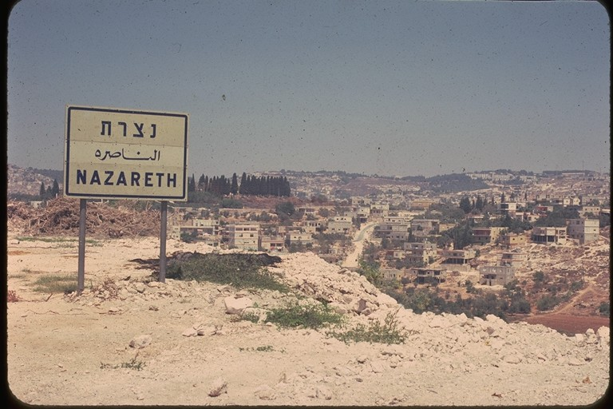
When Joseph hears that Herod is dead they return to their home town of Nazareth where Jesus is raised.
Jesus grew up in Nazareth

Slide 8
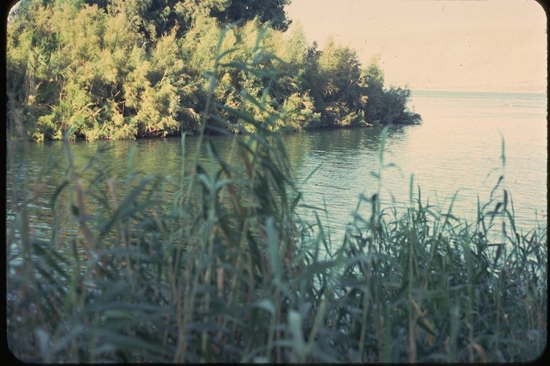
Jordan River
John the Baptist baptizes Jesus

Slide 9
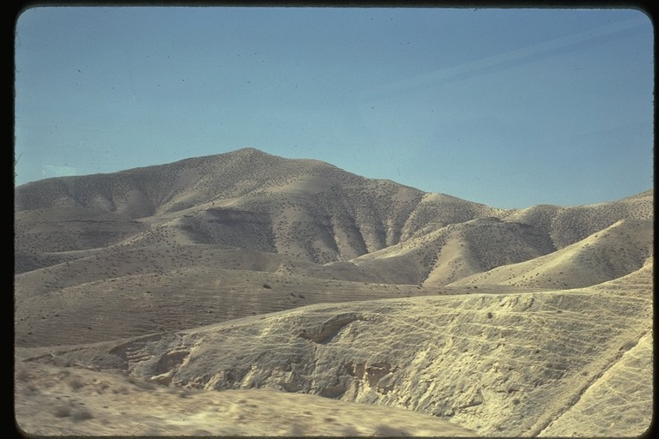
Mount of Temptation
After his baptism, Jesus in led into the wilderness where he is tempted by the devil.

Slide 10
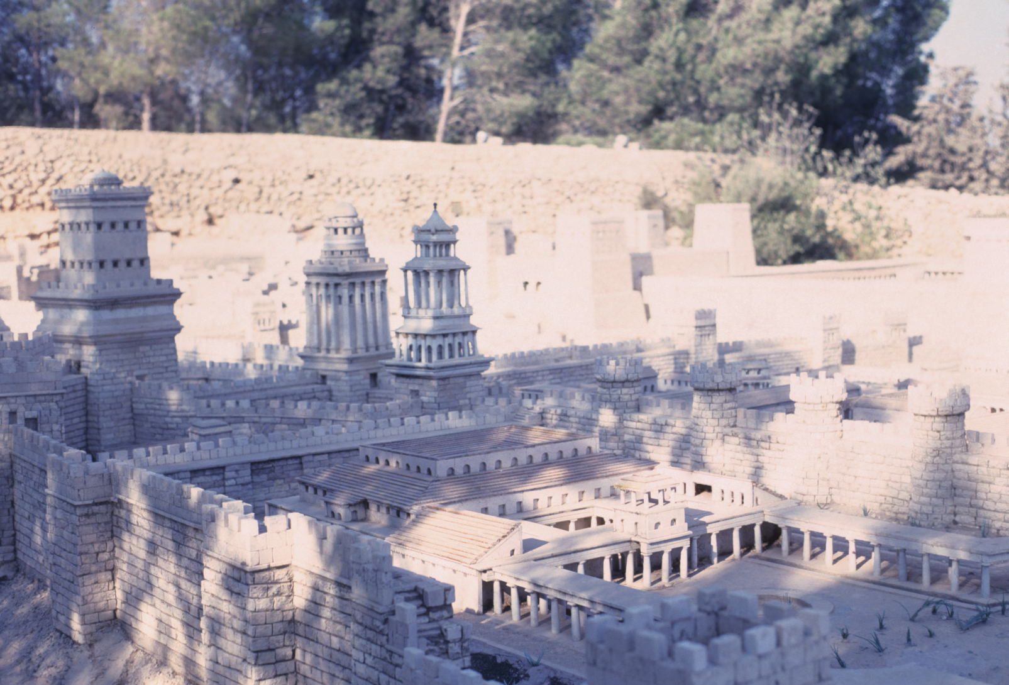
Herod’s Temple Complex
Jesus Cleanses the Temple; the money changers are chased away.
This begins his 8 month early Judean ministry (John 2:13)

Slide 11
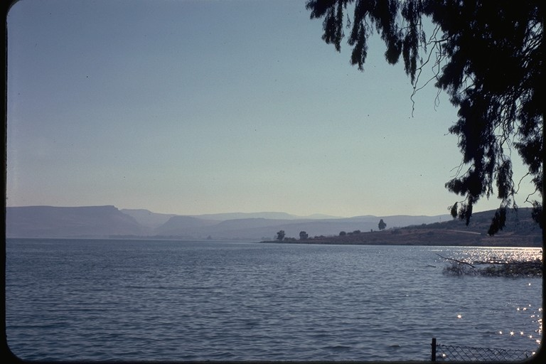
Jesus returns to Galilee and begins his Galilean ministry that lasts almost two years.
Sea of Galilee

Slide 12
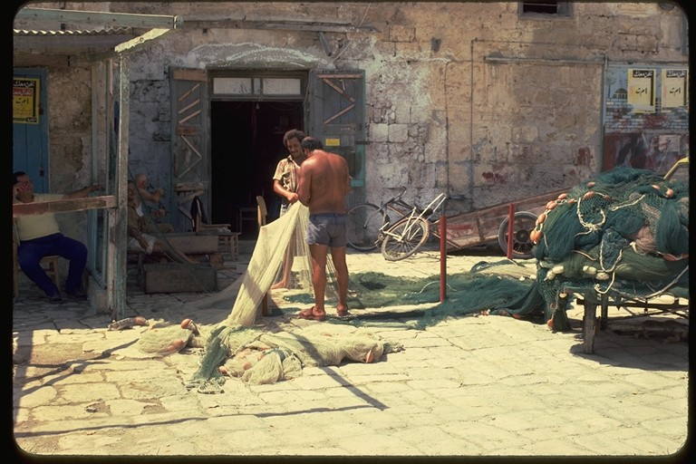
Fisher of Men
Peter, James & John were fishermen who became disciples of Jesus.

Slide 13
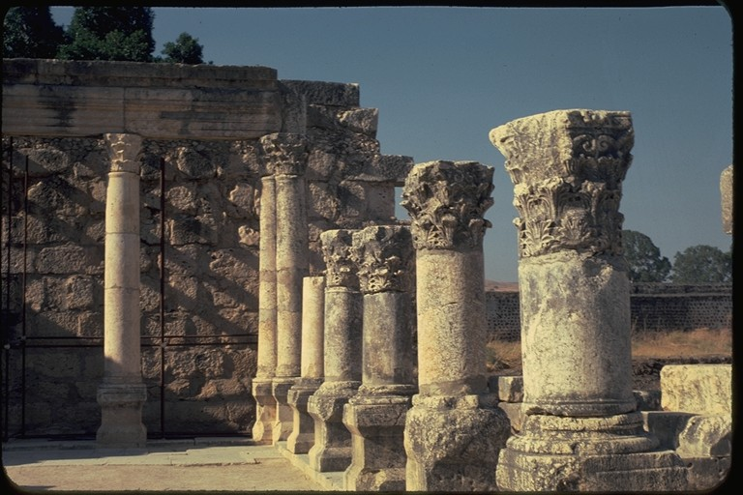
Capernaum
Synagogue where Jesus preached

Slide 14
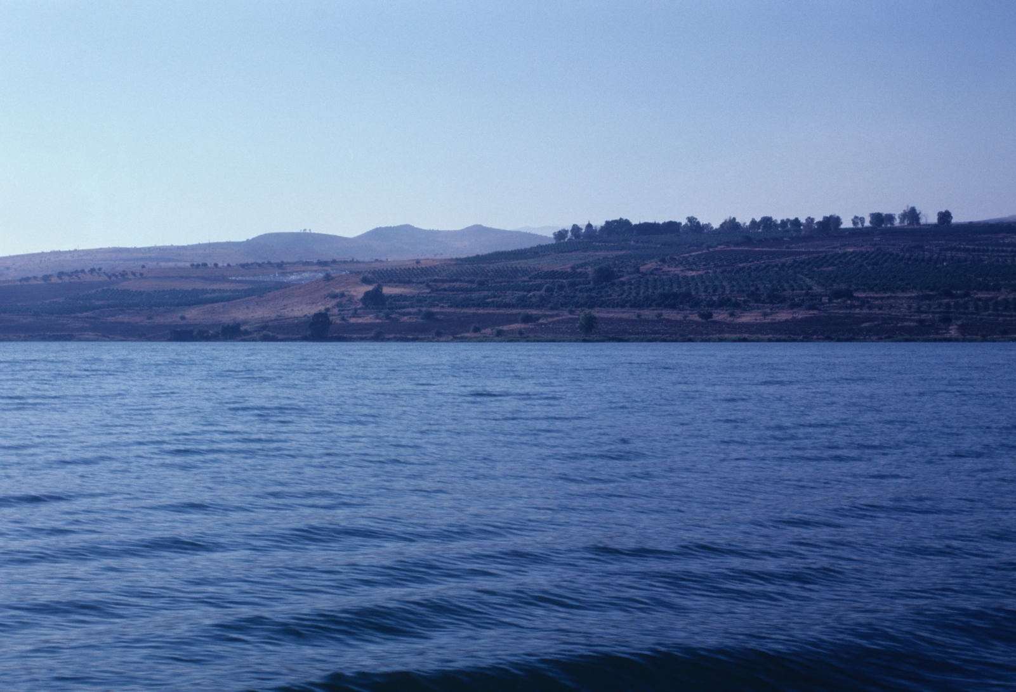
Sermon of the Mount
Sea of Galilee

Slide 15
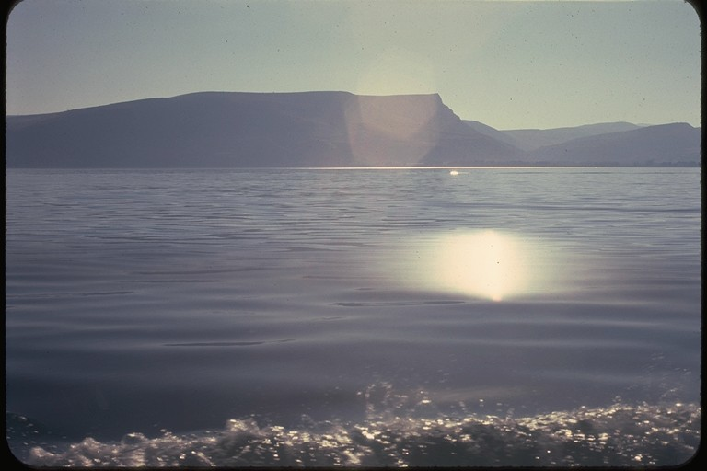
Sea of Galilee
Jesus walks of water

Slide 16
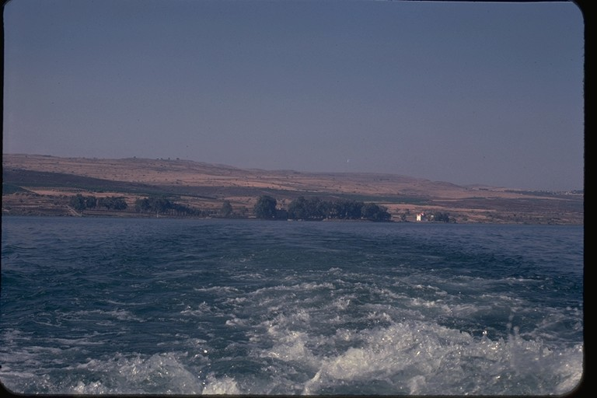
Sea of Galilee
Jesus calms the sea

Slide 17
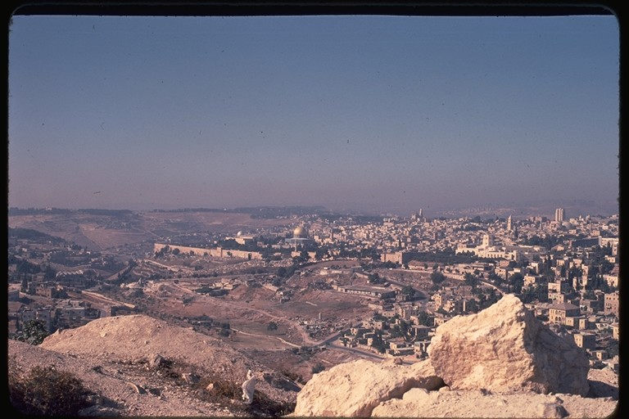
Jesus returns to Jerusalem for the Feast of Tabernacles beginning his 3 month Later Judean ministry.
Jerusalem

Slide 18
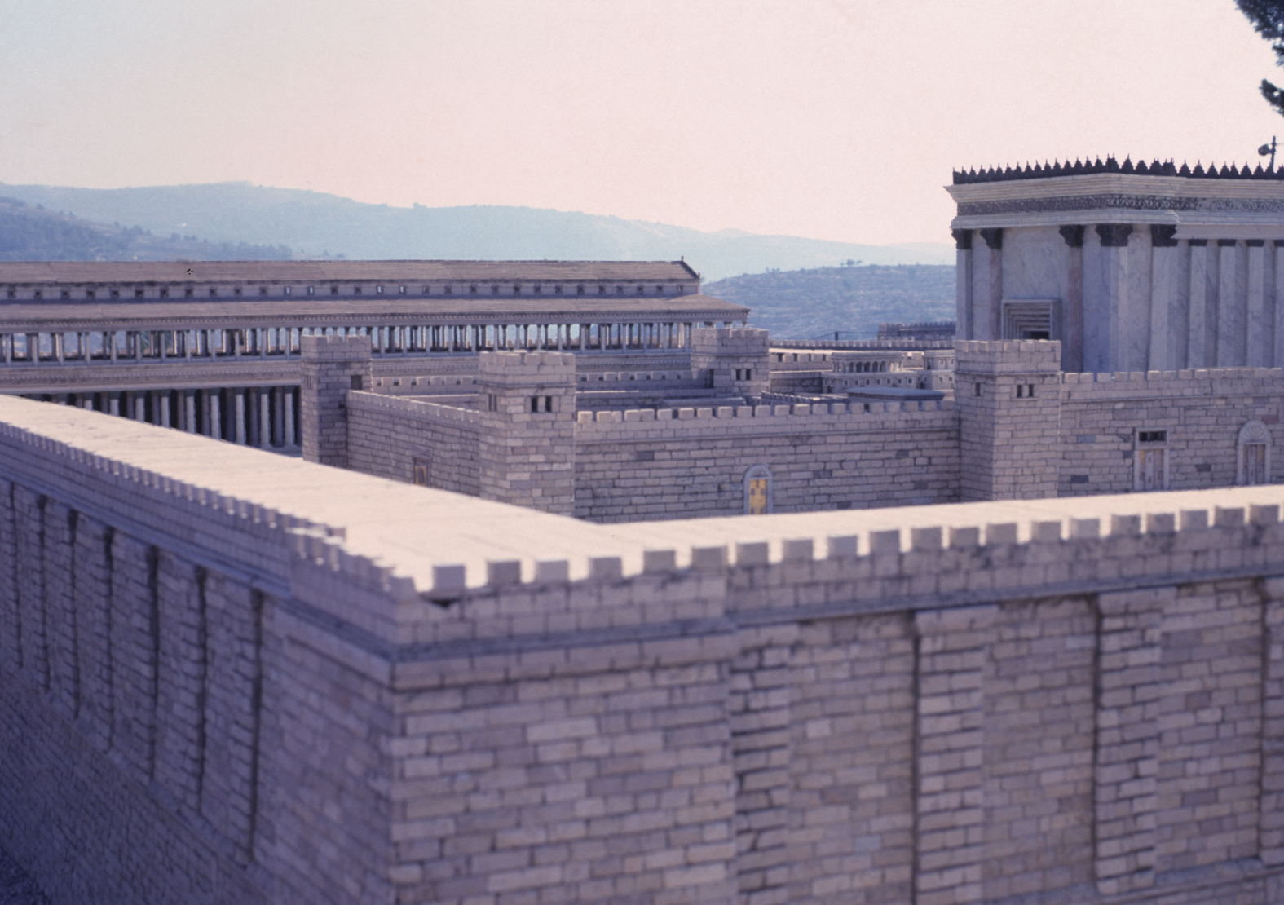
Herod’s Temple
Jesus Teaches in the Temple
(John 7:10-53).

Slide 19
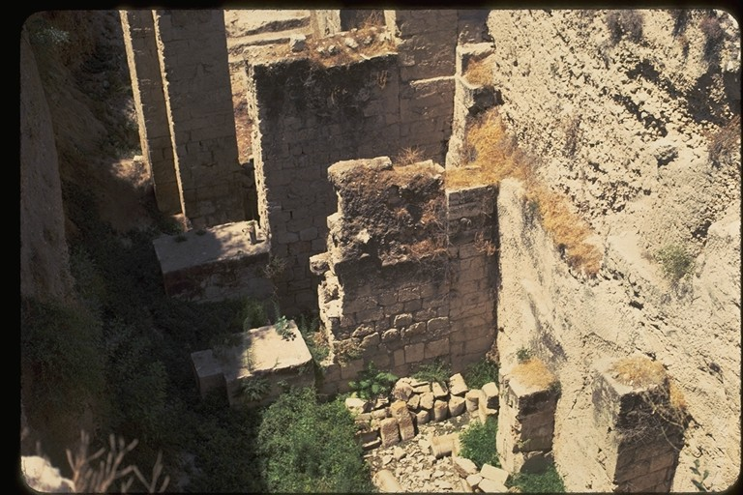
Pool of Siloam
Jesus heals a blind man who is told to wash in the Pool of Siloam (John 9).

Slide 20
Jordan River
Jesus crosses the Jordan River to begin his Perean ministry for 3 months

Slide 21
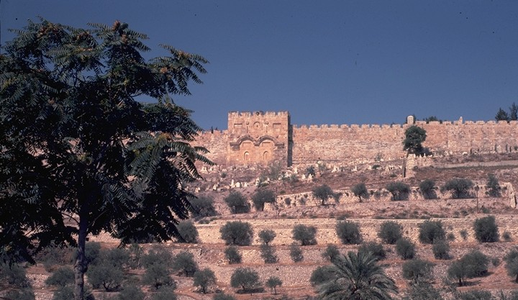
Eastern Gate Jerusalem
Jesus returns to Jerusalem with a triumphal entrance through the eastern gate (John 12). This begins his last or Passion week.

Slide 22
Herod’s Temple Complex
Jesus Cleanses the Temple a second time; the money changers are chased away. (Matthew 21:12) The next day he teaches in the Temple.

Slide 23
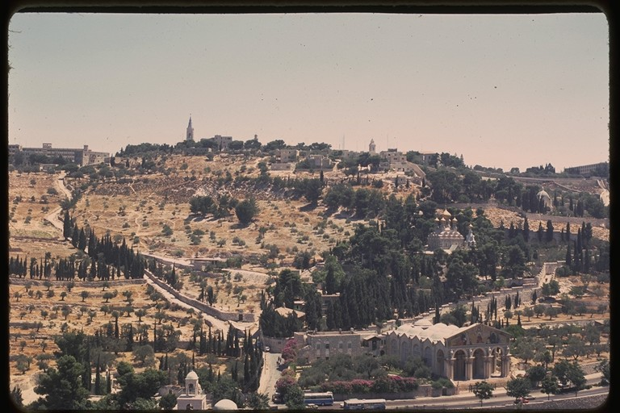
Garden of Gethsemane
After the Last Supper Jesus and his disciples go to the Garden of Gethsemane to pray. Jesus is then betrayed by Judas Matthew 26:36-46

Slide 24
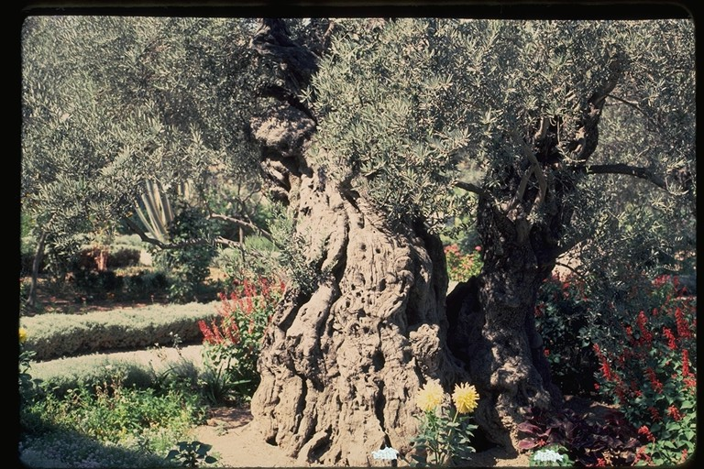
Garden of Gethsemane
Ancient Olive Tree

Slide 25
Herod’s Temple Complex
Jesus is arrested and put on trail (John 18-19).

Slide 26
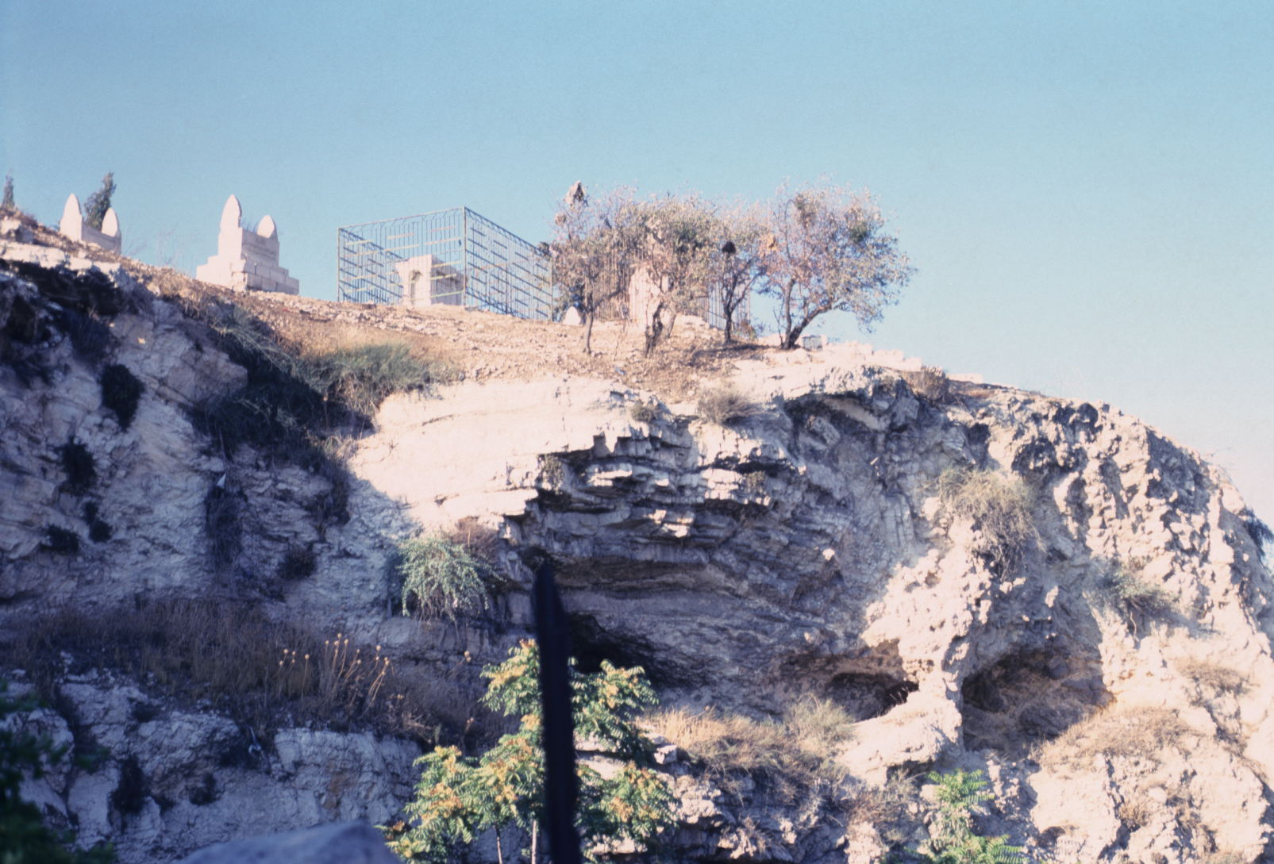
Golgotha: Place of the skull
Jesus is crucified at Golgotha

Slide 27
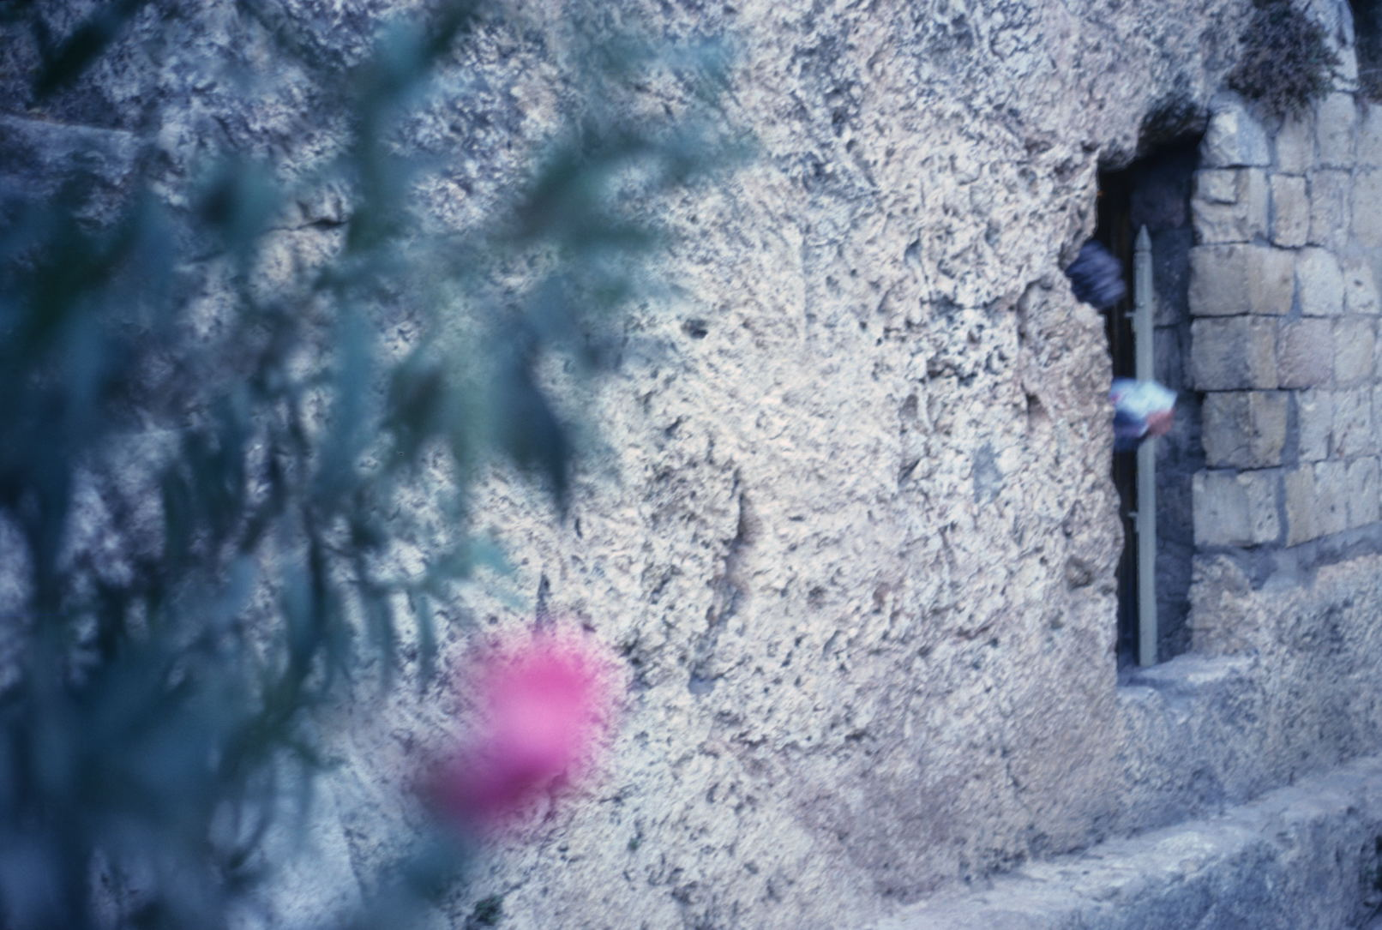
Garden Tomb
Jesus is buried and a stone rolled in front of his tomb. The third day Christ rises from the dead.

Slide 28
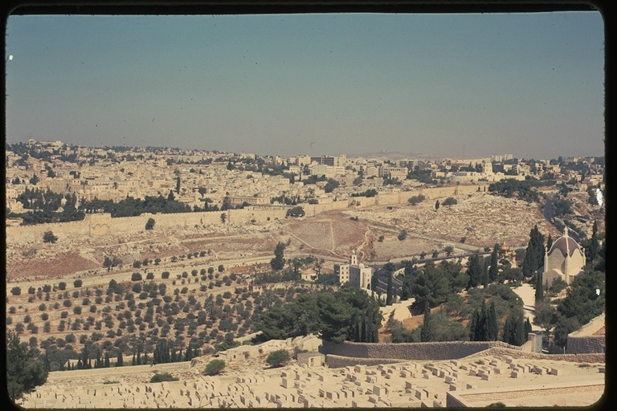
Top of Mount of Olives overlooking Jerusalem
40 days later Jesus ascends back up into heaven from the top of the Mount of Olives (Acts 1:3).

Slide 29
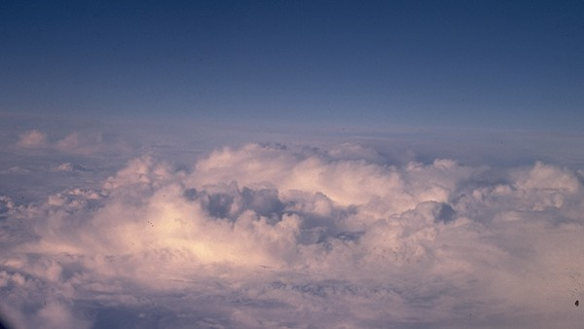
Jesus was taken into heaven in a cloud. Two men state, “Why do you stand here looking into the sky? This same Jesus, who has been taken from you into heaven, will come back in the same way you have seen him go into heaven” Acts 1:11.
Copy write by Dr. Stephen Meyers, www.bibleandscience.com

